Slide 1

AWS Rancher Metrics and Altering

Slide 2
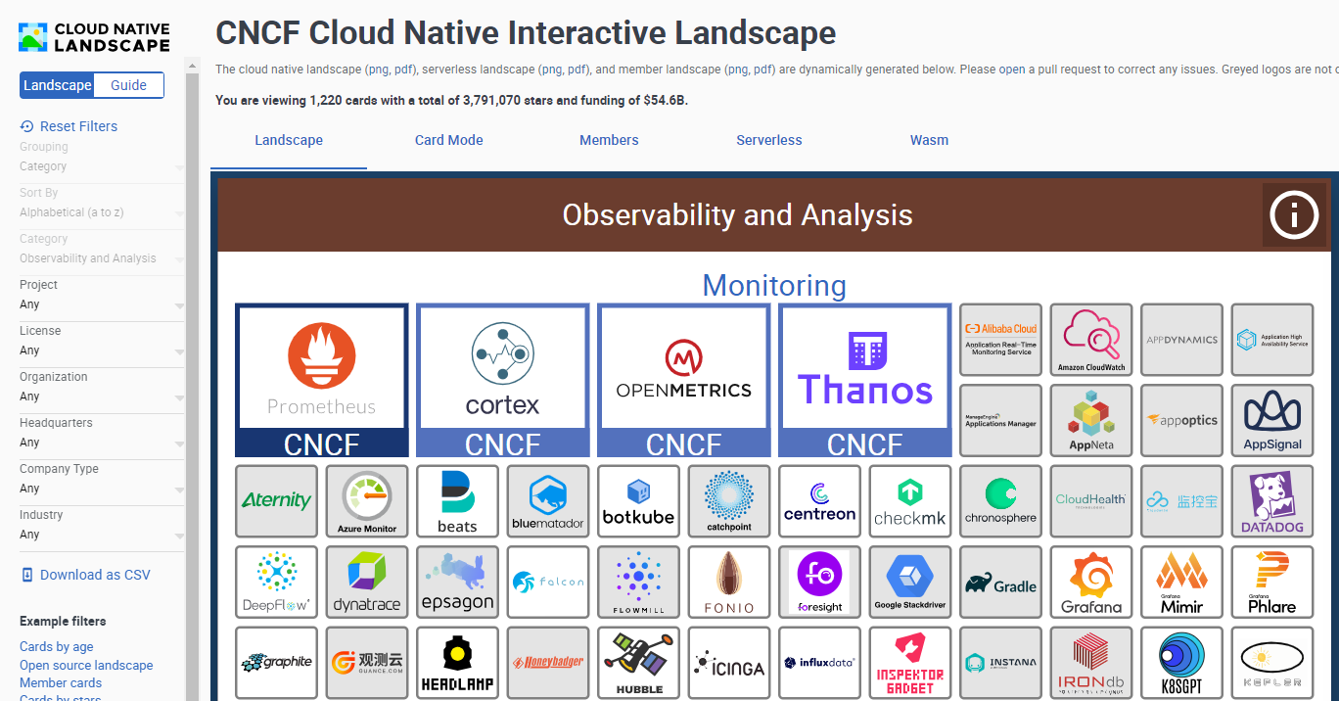
Notes:
https://landscape.cncf.io/?category=observability-and-analysis&grouping=category&zoom=150

Slide 3
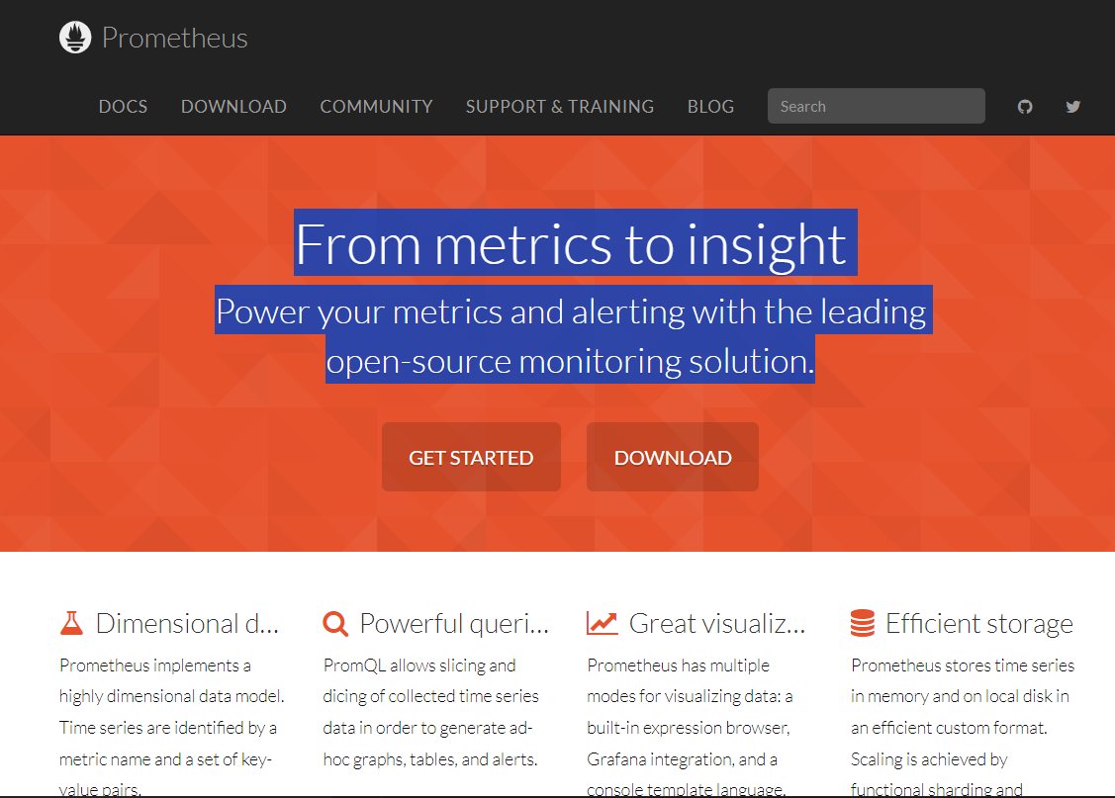
Notes:
https://prometheus.io/

Slide 4
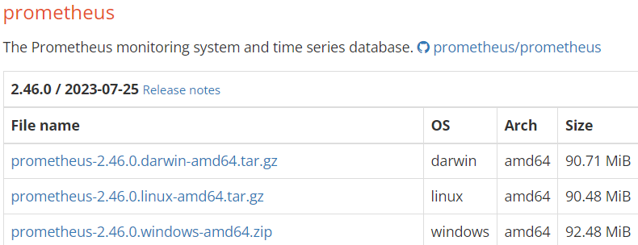
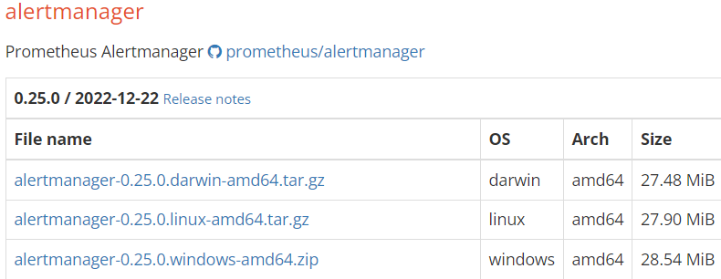
Prometheus&Alertmanager本地部署
Notes:
https://prometheus.io/download/

Slide 5
prometheus.yml
# my global config
global:
scrape_interval: 15s # Set the scrape interval to every 15 seconds. Default is every 1 minute.
evaluation_interval: 15s # Evaluate rules every 15 seconds. The default is every 1 minute.
# scrape_timeout is set to the global default (10s).
# Alertmanager configuration
alerting:
alertmanagers:
- static_configs:
- targets:
- localhost:9093
# - alertmanager:9093
# Load rules once and periodically evaluate them according to the global 'evaluation_interval'.
rule_files:
# - "first_rules.yml"
# - "second_rules.yml"
# A scrape configuration containing exactly one endpoint to scrape:
# Here it's Prometheus itself.
scrape_configs:
# The job name is added as a label `job=<job_name>` to any timeseries scraped from this config.
- job_name: "prometheus"
# metrics_path defaults to '/metrics'
# scheme defaults to 'http'.
static_configs:
- targets: ["localhost:9090"]

Slide 6
alertmanager.yml
route:
group_by: ['alertname']
group_wait: 30s
group_interval: 5m
repeat_interval: 1h
receiver: 'web.hook'
receivers:
- name: 'web.hook'
webhook_configs:
- url: 'http://127.0.0.1:5001/'
inhibit_rules:
- source_match:
severity: 'critical'
target_match:
severity: 'warning'
equal: ['alertname', 'dev', 'instance']

Slide 7
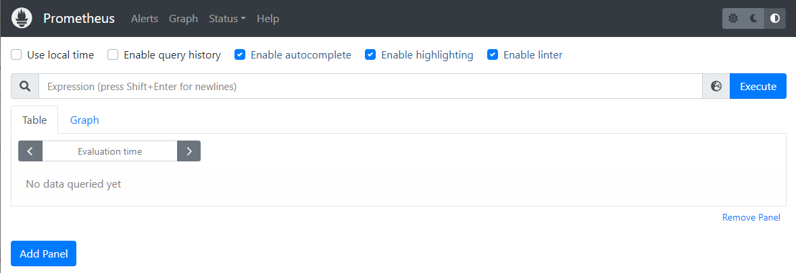
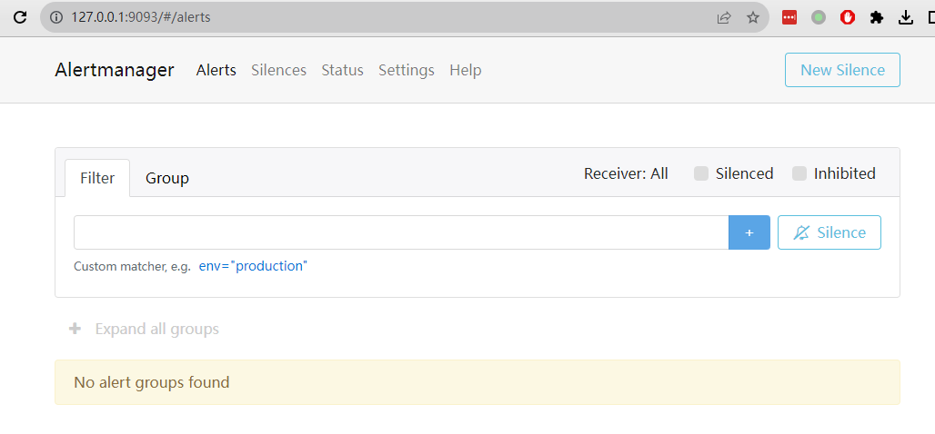

Slide 8
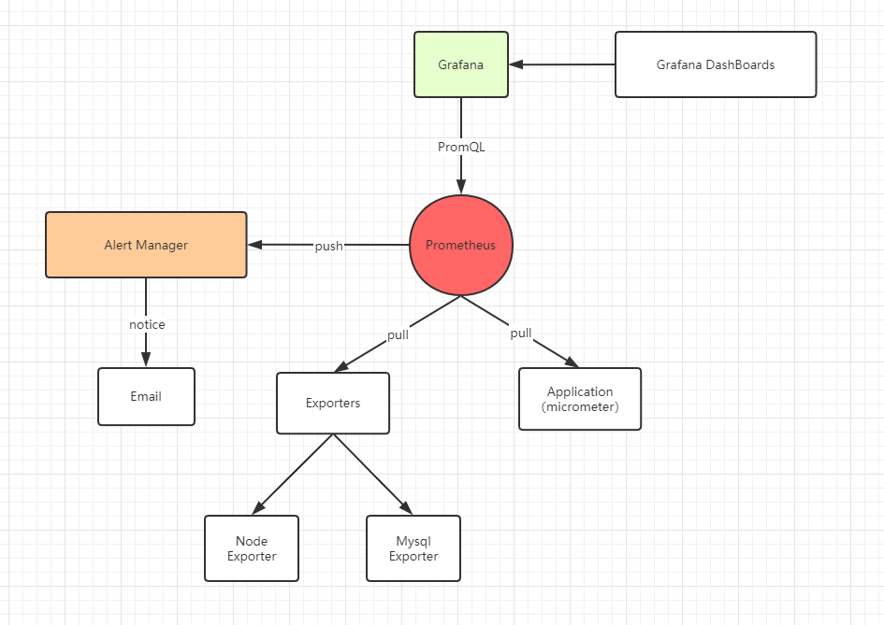
监控服务组件

Slide 9
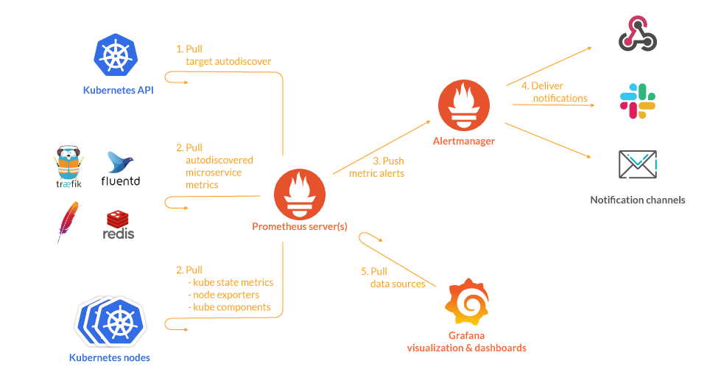
Prometheus K8S部署

Slide 10
Prometheus Operator
Prometheus Operator fully automated way of deploying (like any other standard Kubernetes Deployment object) Prometheus server,
Alertmanager and all the related secrets, configmap etc; that will help to set up Prometheus monitoring ecosystem and instantiate Kubernetes cluster monitoring in just a few minutes.

Slide 11
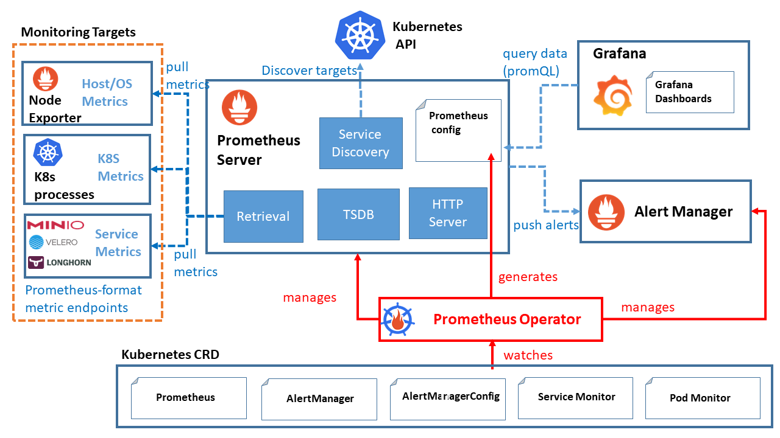

Slide 12
Prometheus Operator自定义资源 (CRD)
prometheuses.monitoring.coreos.com
servicemonitors.monitoring.coreos.com
podmonitors.monitoring.coreos.com
prometheusrules.monitoring.coreos.com
alertmanagers.monitoring.coreos.com
alertmanagerconfigs.monitoring.coreos.com
thanosrulers.monitoring.coreos.com
probes.monitoring.coreos.com

Slide 13
Prometheus Operator自定义资源 (CRD)
Prometheus: defines the desired Prometheus deployments as a StatefulSet
Alertmanager: defines a desired Alertmanager deployment
ServiceMonitor: declaratively specifies how groups of Kubernetes services should be monitored
PodMonitor: declaratively specifies how groups of pods should be monitored
Probe: declaratively specifies how groups of ingresses or static targets should be monitored
PrometheusRule: defines a desired set of Prometheus alerting and/or recording rules
AlertmanagerConfig: declaratively specifies subsections of the Alertmanager configuration

Slide 14
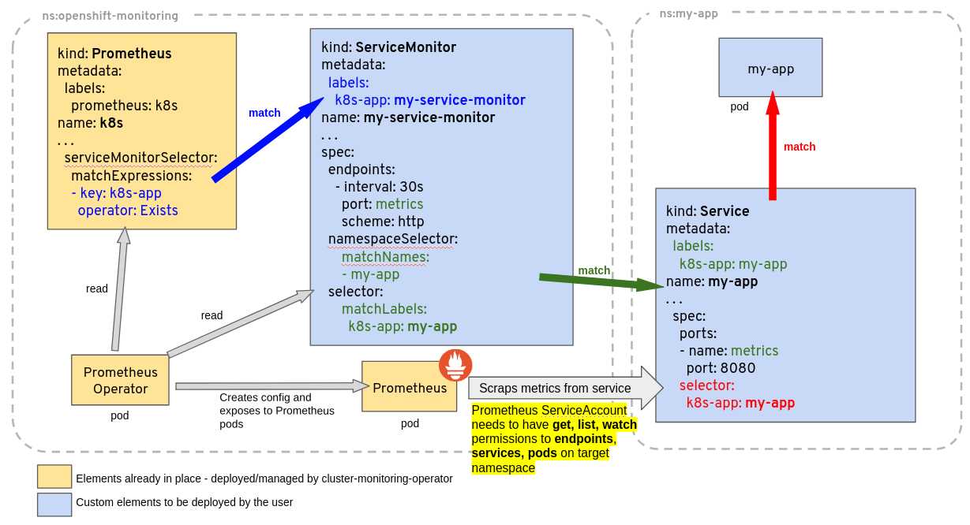

Slide 15
监控K8S服务配置
# Source: mde-css/templates/servicemonitor.yaml
apiVersion: monitoring.coreos.com/v1
kind: ServiceMonitor
metadata:
name: mde-css-test-install-name-service-monitor
namespace: "ctl-kube-prometheus"
labels:
app.kubernetes.io/instance: "ctl-kube-prometheus"
app.kubernetes.io/name: "kube-prometheus"
spec:
selector:
matchLabels:
app: mde-css
release: test-install-name
endpoints:
- port: mdecss-service
interval: 10s
scrapeTimeout: 10s
namespaceSelector:
matchNames:
- default

Slide 16
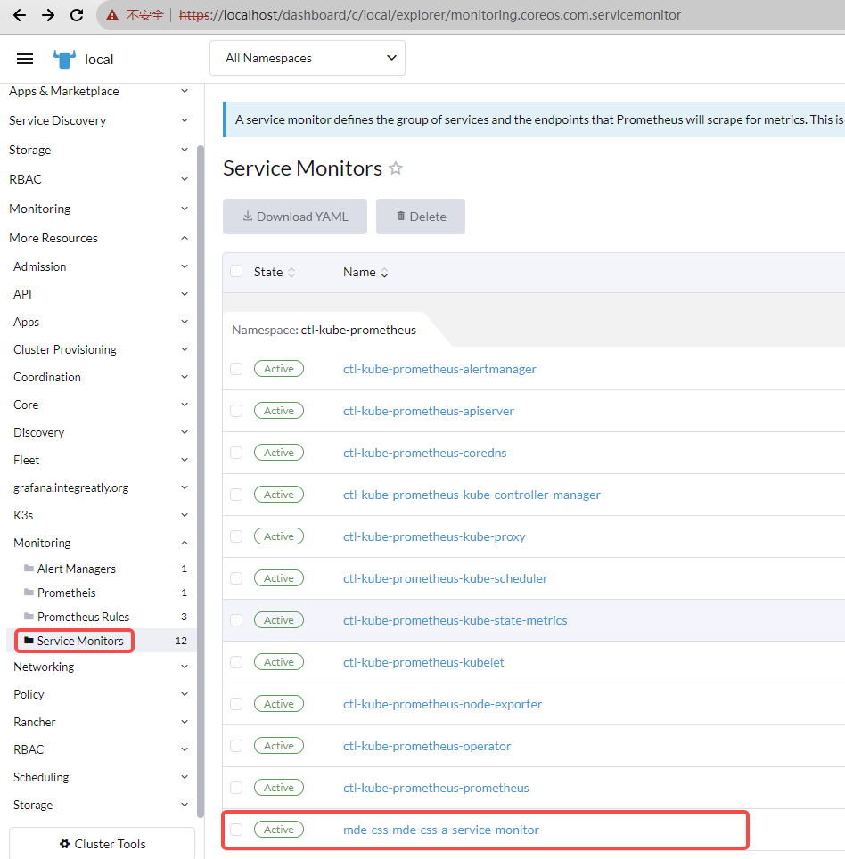

Slide 17
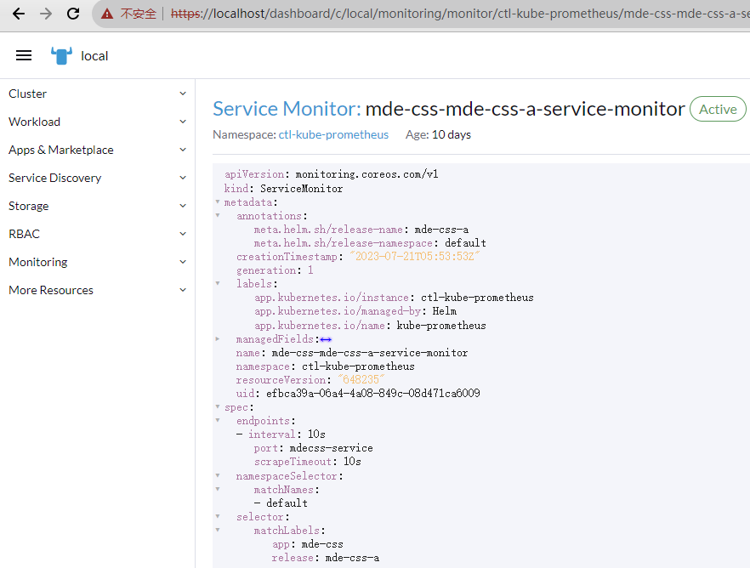

Slide 18
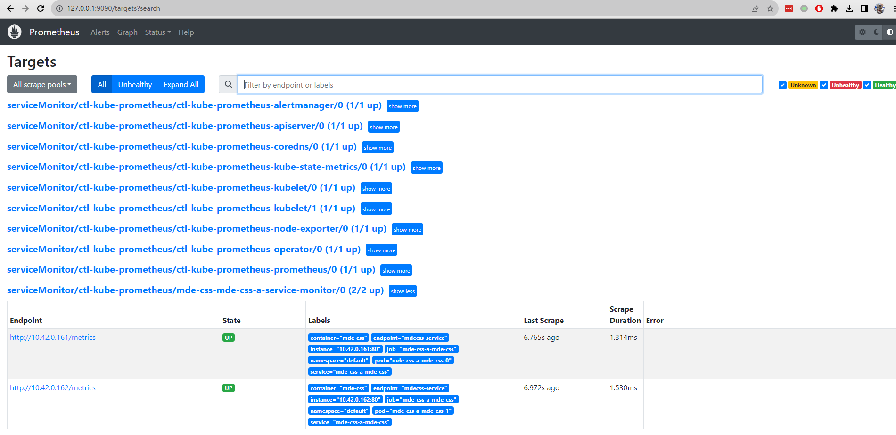

Slide 19
在K8S中配置告警规则
apiVersion: monitoring.coreos.com/v1
kind: PrometheusRule
metadata:
labels:
role: md-alert-rules
name: md-prometheus-example1-rule
spec:
groups:
- name: md-alert-rule
rules:
- alert: MdExampleOneAlert
expr: md_css_http_requests_total > 20000
for: 30s
labels:
severity: critical
annotations:
title: "{{$labels.instance}} high 5xx rate on {{$labels.path}}"
description: "The 5xx error rate for path {{$labels.path}} on {{$labels.instance}} is {{$value}}%."

Slide 20
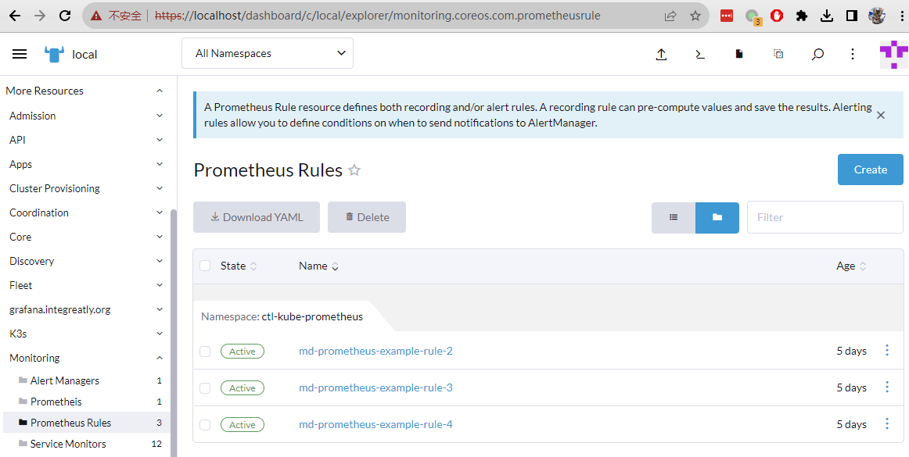

Slide 21
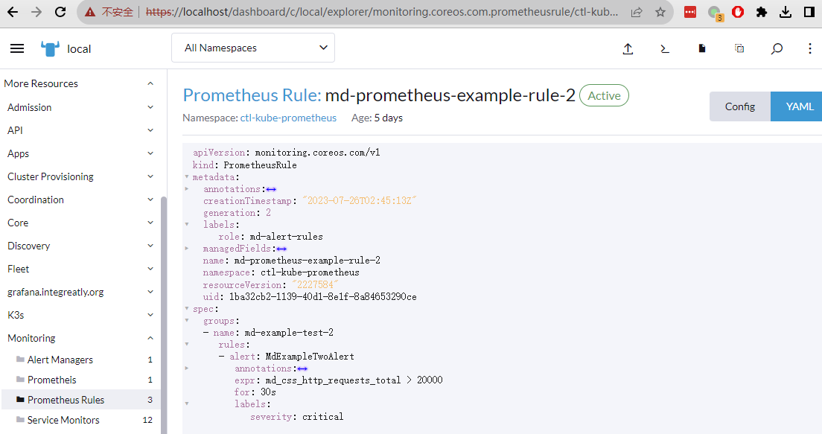

Slide 22
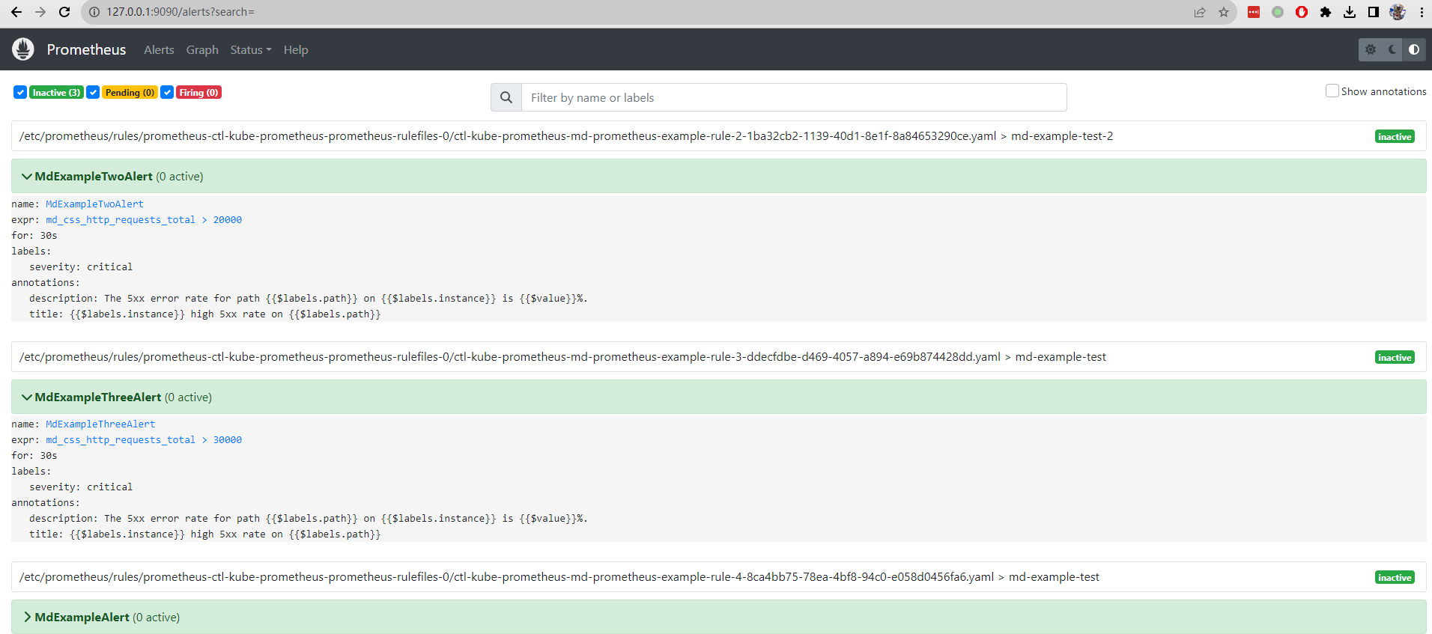
查看K8S中配置alert rule效果

Slide 23
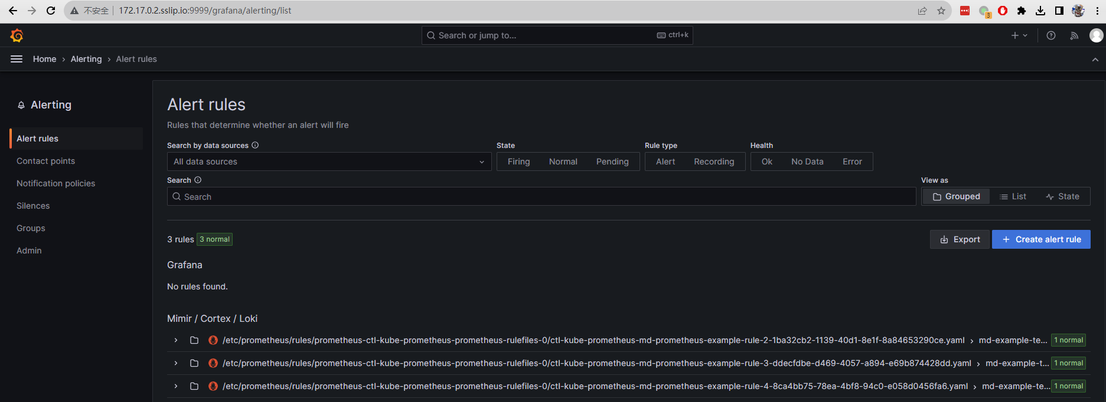

Slide 24
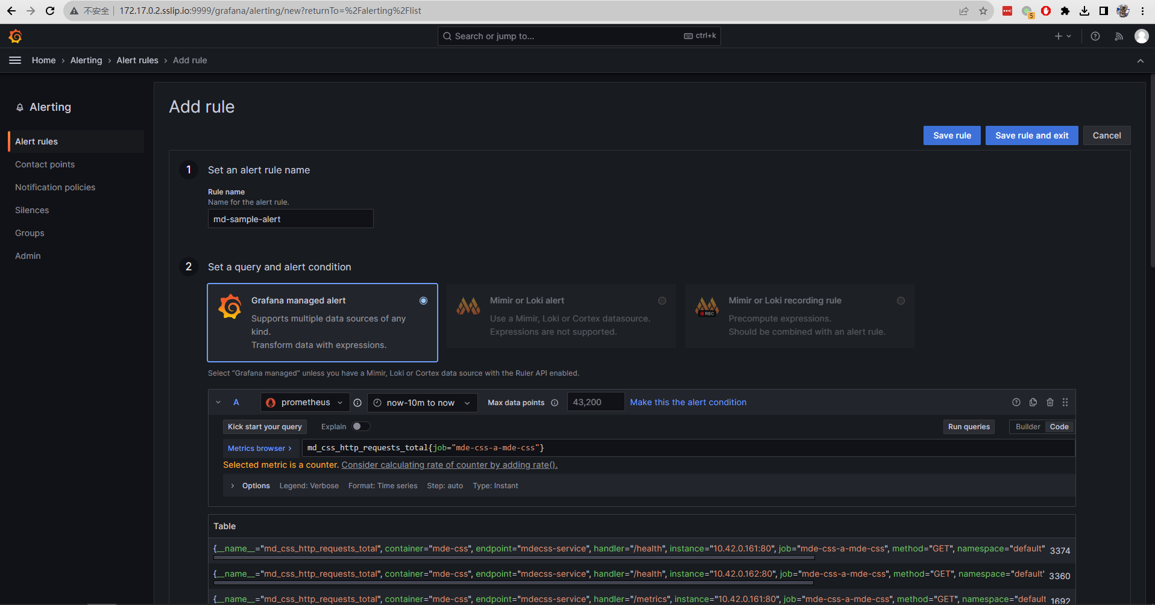
使用Grafana配置告警规则

Slide 25
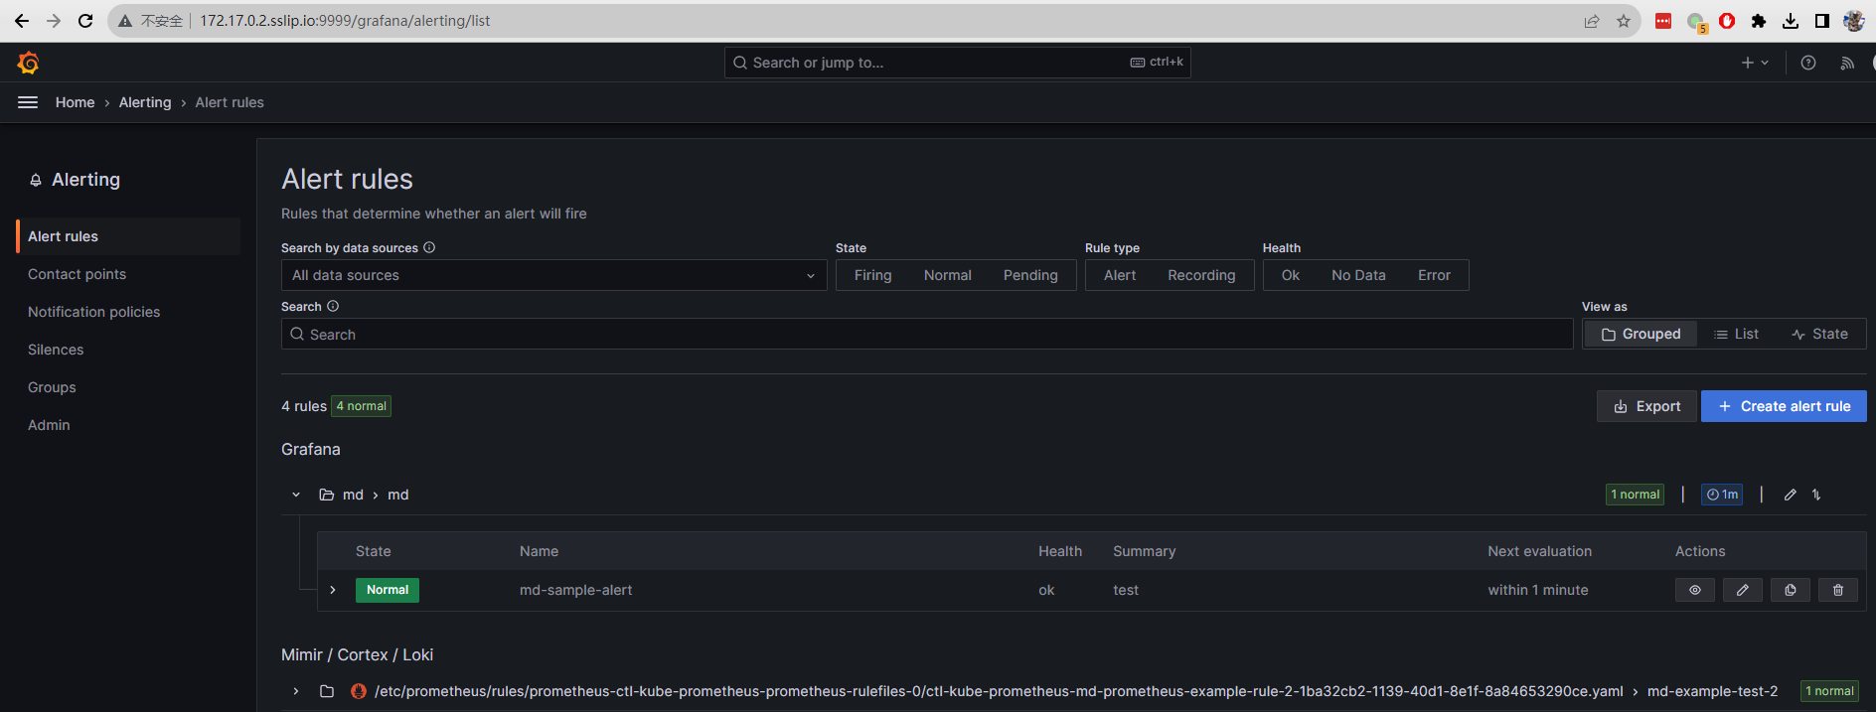
Notes:
更过公共告警规则可以参考github仓库Awesome Prometheus alerts
Collection of alerting rules
https://samber.github.io/awesome-prometheus-alerts/rules.html#kubernetes

Slide 26
参考文档
使用Prometheus Operator部署并管理Prometheus Server
Promethues + Grafana + AlertManager使用总结
Awesome Prometheus alerts

